Slide 1
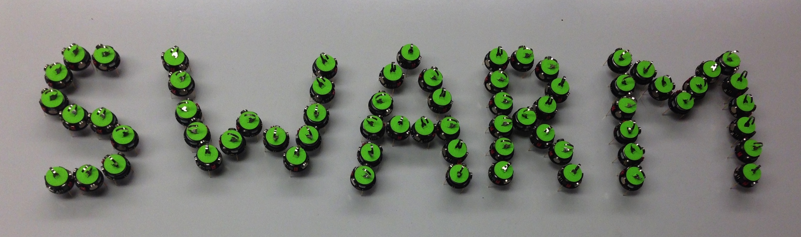
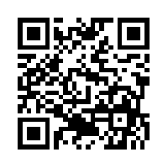

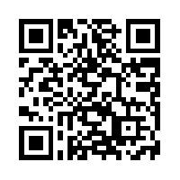
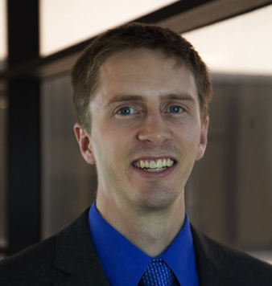
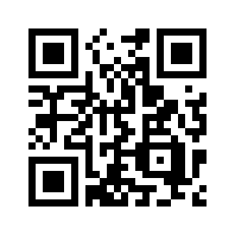
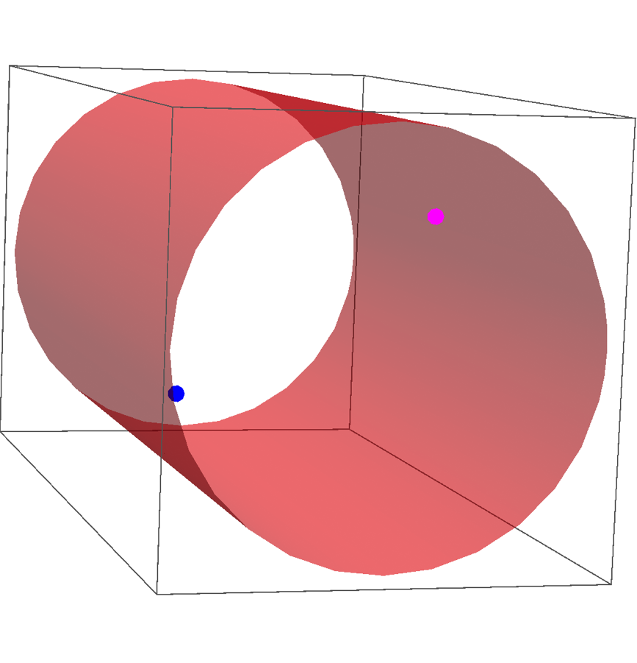
Shaping a Particle Swarm With a Shared Control Input Using Boundary Interaction
Shiva Shahrokhi, Aaron T. Becker
sshahrokhi2@uh.edu, atbecker@uh.edu .
Department of Electrical and Computer Engineering,
University of Houston
Website, C.V.
YouTube channel
Global inputs: symmetry
Best-first search algorithm
Results
Global inputs: All robots get the
same input
Symmetry: control 2 of 2n DOF
Previous work: used a single obstacle
in the middle of the workspace
Constraints: this obstacle is impractical,
especially in 3D
The shortest path when Δg is reachable is when the robot that collides with the wall moves toward the reflection of its goal.
Using boundary interaction
Another way to break symmetry is using boundaries:
usually workspaces have boundaries.
If a robot is touching a wall, the other robot can go anywhere in the reachable set while the first robot is immobile.
Δ configuration space shows reachable Δg by moving one robot to touch a wall and then adjusting the second robot.
5
4
3
Distance and number of moves for different goal positions of the blue robot when all the other positions are fixed
ε= 0.001
ε= 0.05
ε = 0.1
Current work: circular workspace
ε is used to ensure particles do not overlap
1
2
3
youtu.be/5t1BTPhLod8
4
5
6
Sequence of moves to goal position:
An A*-like algorithm considers all potential paths to find the shortest one using best-first search
Algorithm extends naturally to 3D
Cylindrical workspaces are common in biology

